Slide 1



Marketing Campaign Prediction
Reddy Charan Pulivendula
Pandya Harsh Maheshkumar
Sheta Rushank Ghanshyam

Slide 2
Abstract
On average a company spends 4% to 25% of their net revenue into Marketing campaigns and Advertisements
While some companies like Salesforce and Tableau spent around 50% of their revenue in marketing campaigns
Targeted marketing is used to get good returns from this investment which aims at identifying groups of customers which are highly likely to become future customers
Customer segmentation allows us to group customers based on demographics, geography, interests, user activity, etc.

Slide 3
Problem Statement
Marketing campaign analysis allows companies to find customers which are highly likely to become future customer
Using historical data from previous marketing campaigns to predict the response of a new customer applying predictive modeling
Use customer demographics like age, income, marital status, etc. to classify if a new customer will respond positively or negatively to the campaigns

Slide 4
Related Work
Performed steps like:
EDA on Data Set
Correlation Analysis
Handling Missing Data
Feature Engineering
Binary Classification

Slide 5
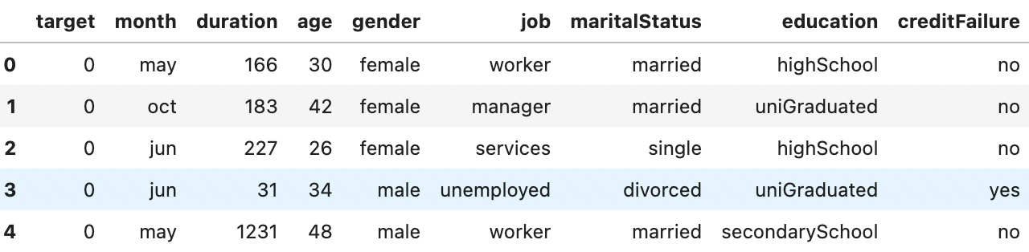
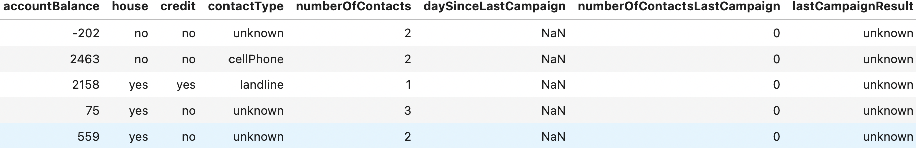
Data

Slide 6
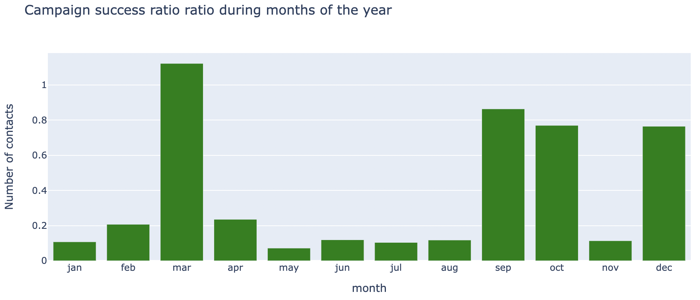
Univariate Analysis

Slide 7
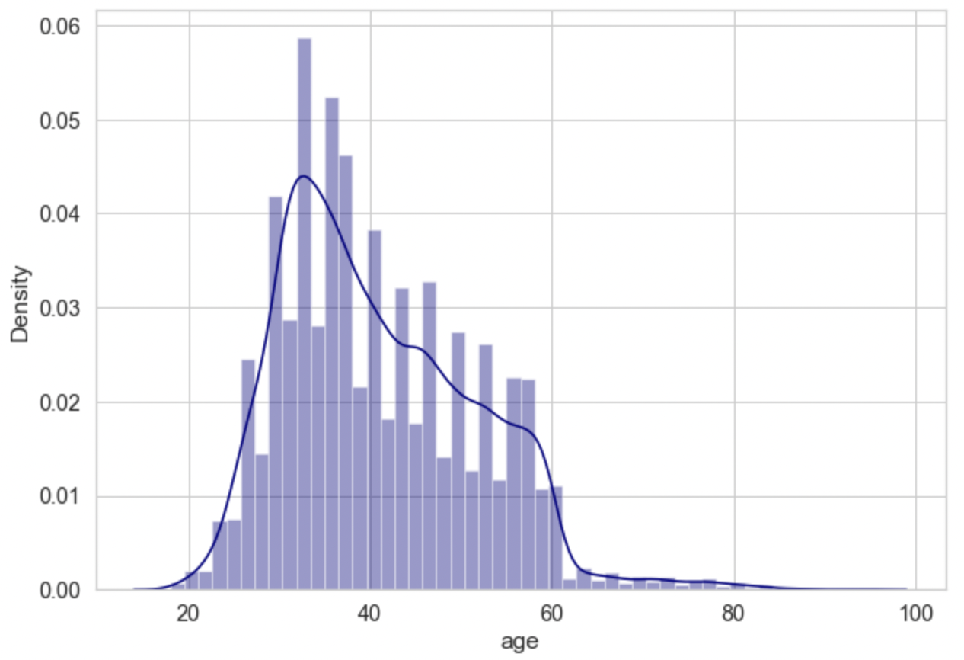
Univariate Analysis

Slide 8
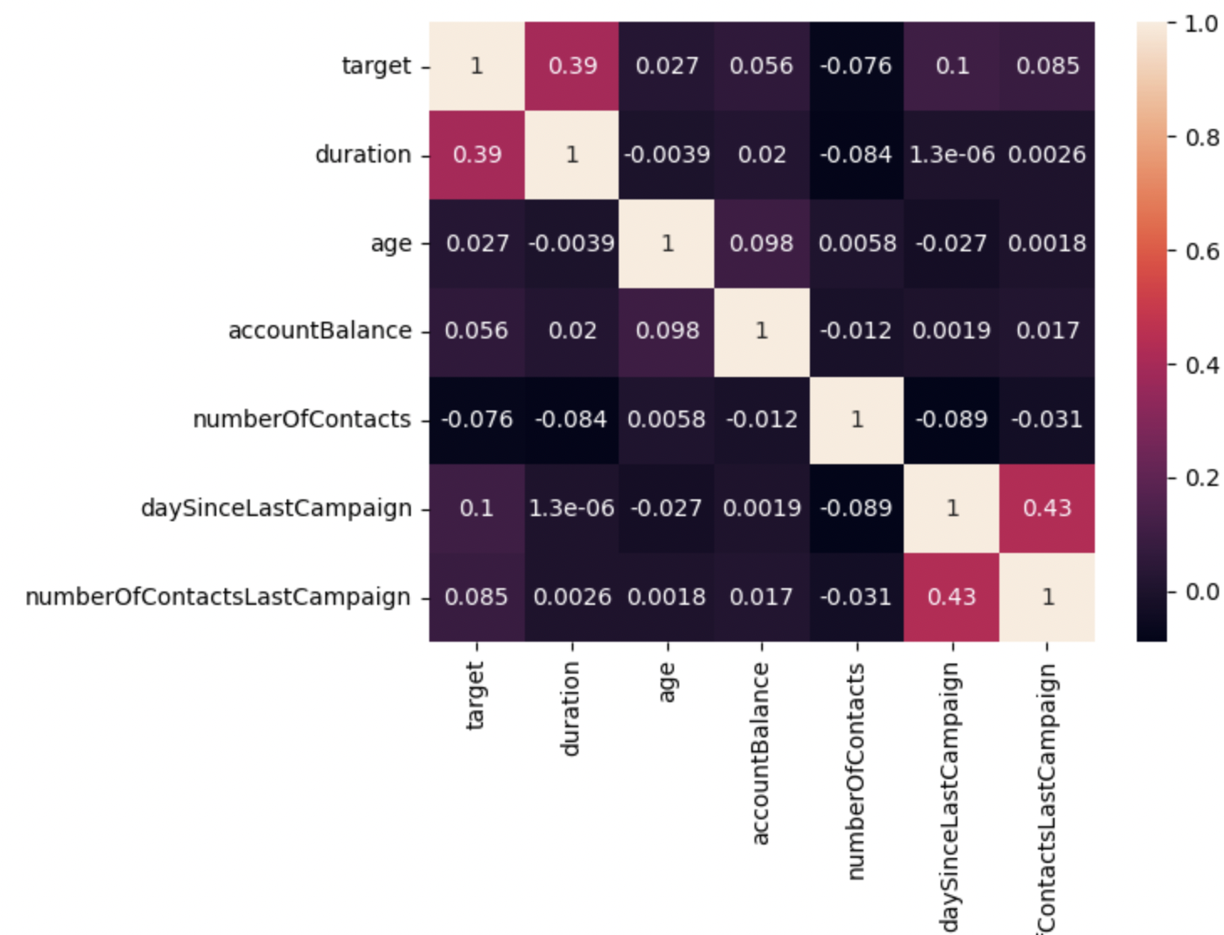
Correlation Analysis

Slide 9
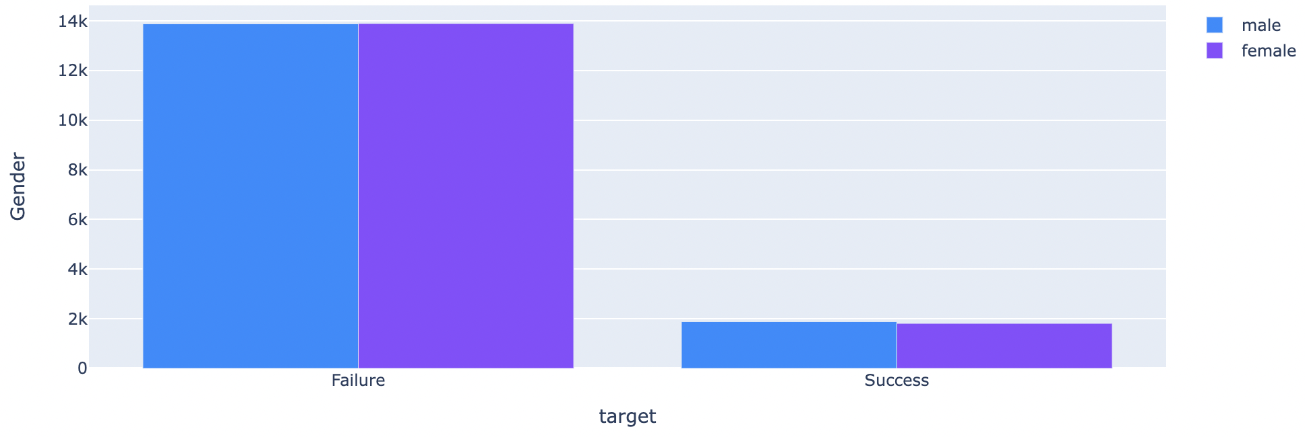
Bivariate Anaysis
x

Slide 10
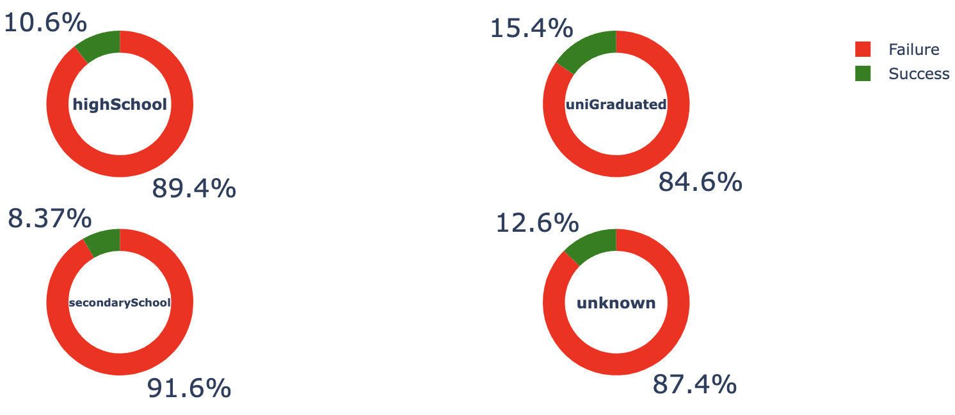
Bivariate Analysis

Slide 11
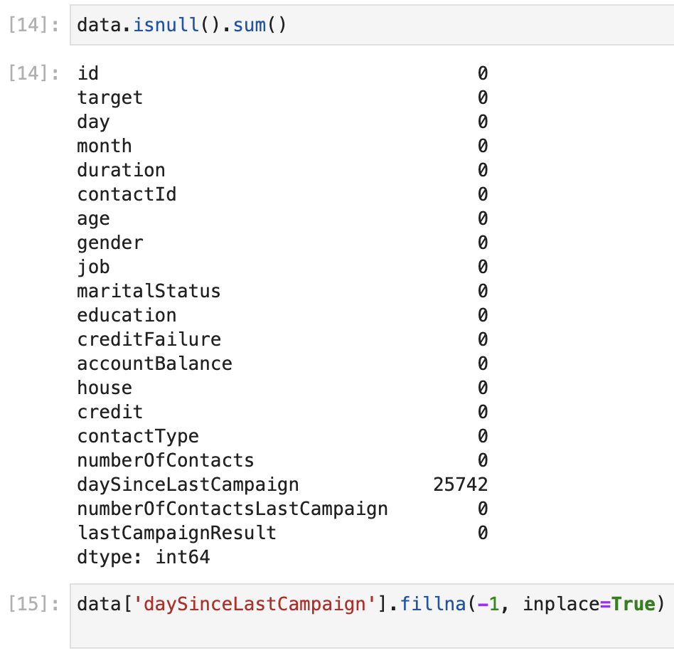
Handling null values
Replacing null values with -1, which implies that
the customer did not respond positively in previous
campaign

Slide 12
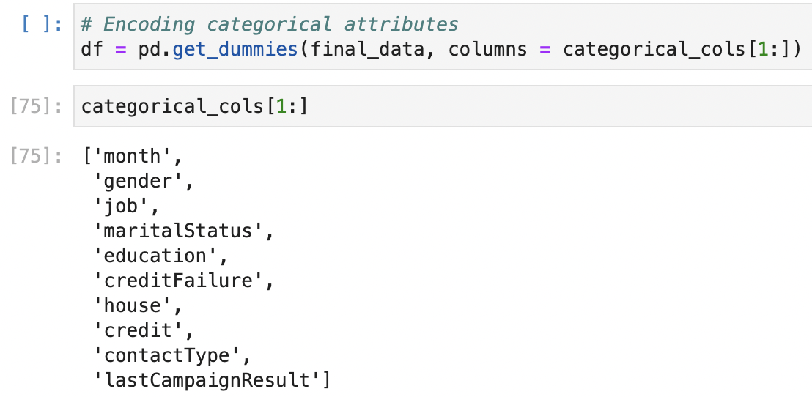
Data pre-processing

Slide 13
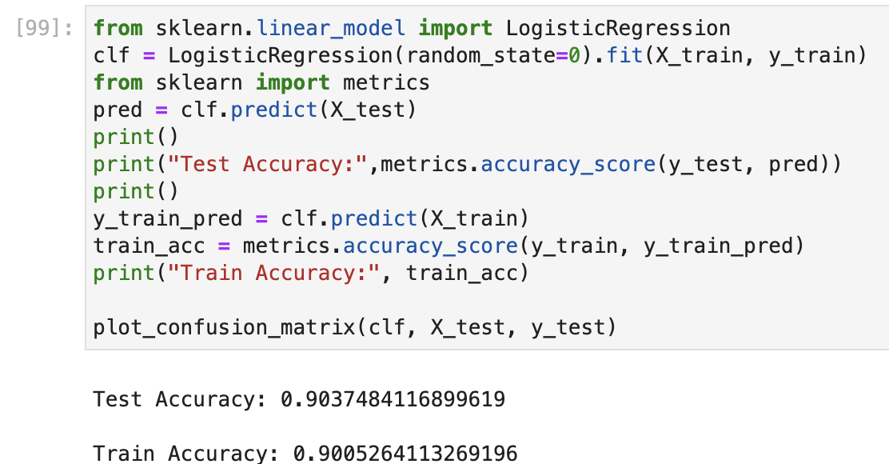
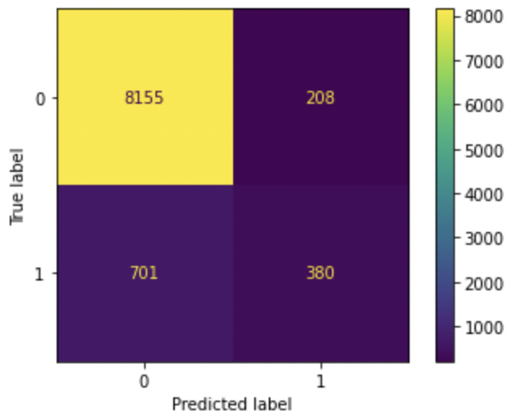
Logistic Regression

Slide 14
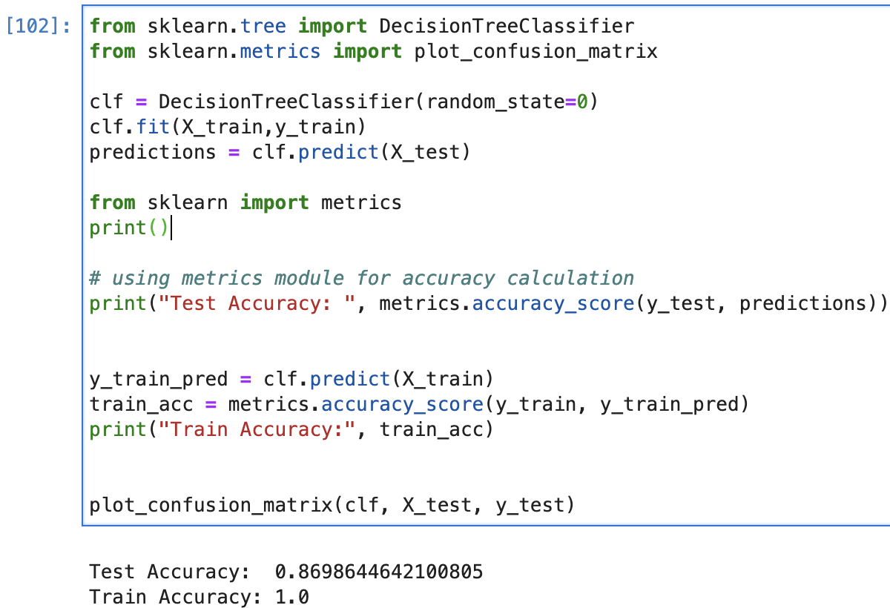
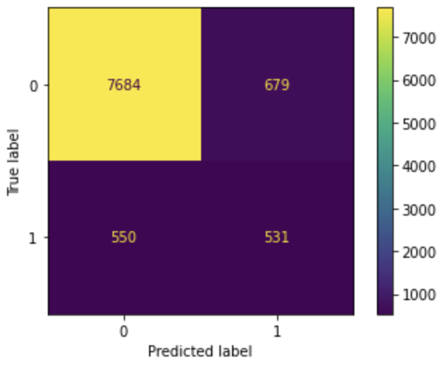
Decision Tree

Slide 15
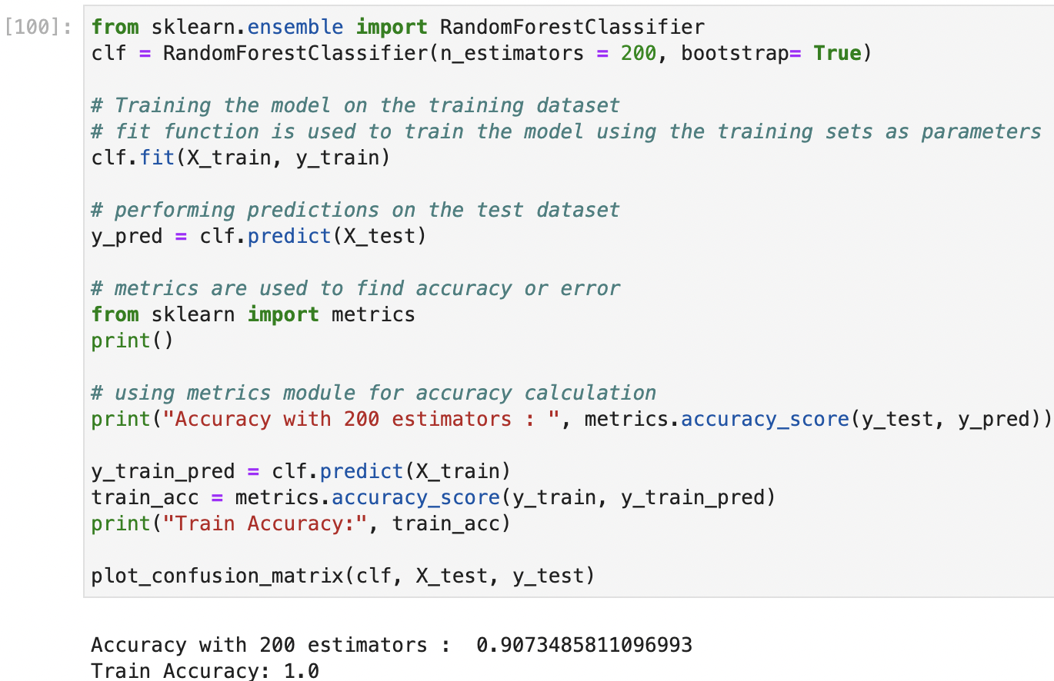
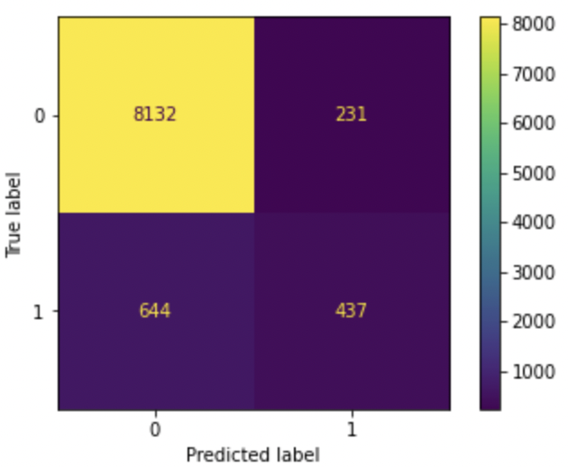
Random Forest

Slide 16
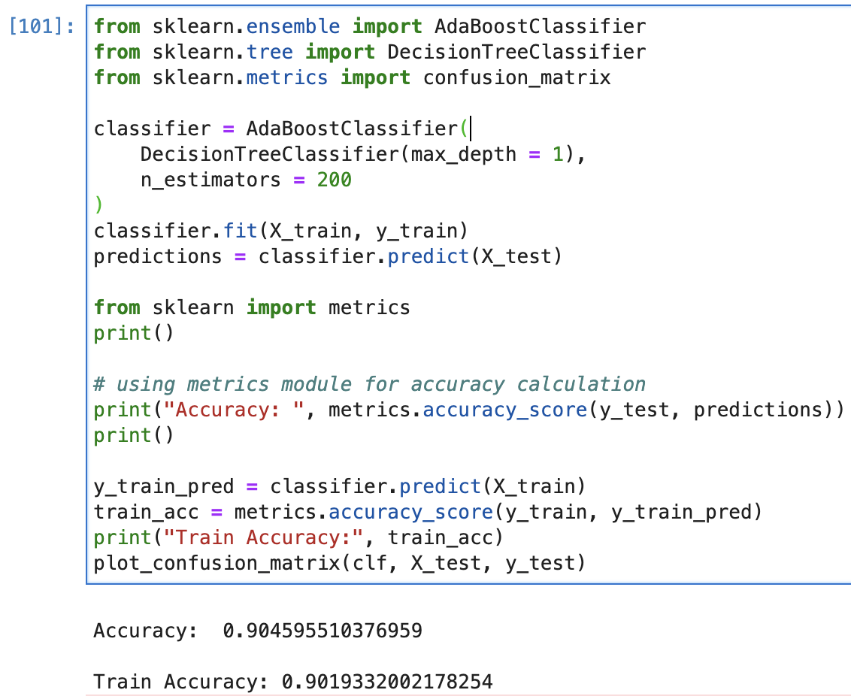

Boosting

Slide 17
Results and Challenges
Random Forest classifier results in best test accuracy
Models are highly training data specific
Data authenticity and Quality issues
Many irrelevant features
Limited availability of open source data
Class Imbalance
Notes:
Random forest provides best test accuracy of 90.7%
Models are highly training data specific because we can not apply predictive model which is trained on marketing campaign for a cosmetic product to make predictions for a product of some other category
Since companies spend millions of dollars on these campaigns and also due to privacy issues the datasets are very limited
Also we have to address the class imbalance probelm

Slide 18
Future Scope
Apply methods to reduce impact of class imbalance on the classifier
Experiment with different combination of features
Optimize current models
Utilize more classification metrics to assess model’s performance

Slide 19
References
https://www.kaggle.com/code/khanimar/bi-marketing-campaign-eda-analysis-prediction/data
https://towardsdatascience.com/how-to-predict-the-success-of-your-marketing-campaign-579fbb153a97
https://www.kaggle.com/code/seananguyen/marketing-campaign-analysis-python#3.-Data-Visualizations
https://waypointmc.com/blog/analyzing-marketing-results#:~:text=What%20is%20Marketing%20Analysis%3F,improve%20future%20conversions%20or%20sales.

